Slide 1
San Francisco crime classification
By: Nourhan Waleed Aboelsoaoud

Slide 2
Summary:
It’s a Crime classification project where the category of the crime is predicted according to the crime’s time and place
3 classification models are used – Random Forest Classifier
– Decision Tree
– SVM
Data Cleaning is done, as outliers were fixed, and useless columns dropped
Several Plots were made, such as bar plots, correlation heat maps and box plots

Slide 3
How can this project be used?
The models used can be used to classify any given data into 2+ categories.
However, the time taken differs according to which model is used, for the models I used, SVM took the longest time to the point where I had to give it less data
Their accuracies also differ, The Random Forest Classifier gave the highest accuracy while the SVM gave the lowest, even after tuning

Slide 4
Skills I gained from this training Program
Learned several machine learning models, for supervised, unsupervised and semi supervised learning.
Got into Deep learning and Neural networks

Slide 5
Data-Frame
Date: The recorded timestamp of the crime
Category of the recorded crime
Description : a short note on the crime
DayOfWeek: the day on which the crime took place
PdDistricit : the police department ,under which the crime is reported
Resolution : the status of the crime(Resolved/Unresolved)
Address : the Address of the crime scene
X: latitude of the crime scene
Y: the longitude of the crime scene

Slide 6
Data Preprocessing
There are no null values , and the data is very detailed .
We use Label encoding to turn more ambiguous categorical data, such as strings, into integers with a 1:1 category to integer ratio. Use collections.defaultdict to create a dictionary that has a default value when a key is accessed for the first time.

Slide 7
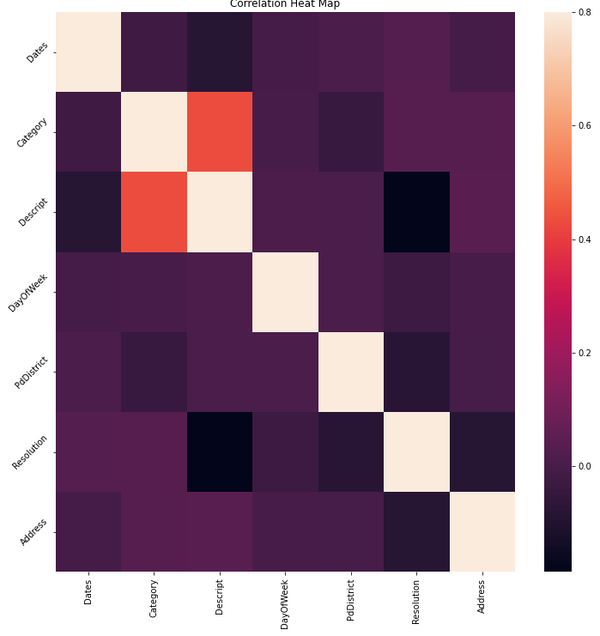
Visualizations/Analysis
Correlation heat map : graphical representation of correlation matrix representing correlation between different variables. The value of correlation can take any values from -1 to 1.
Train data set :
given all features to show which columns depend on which, and to what extent.

Slide 8
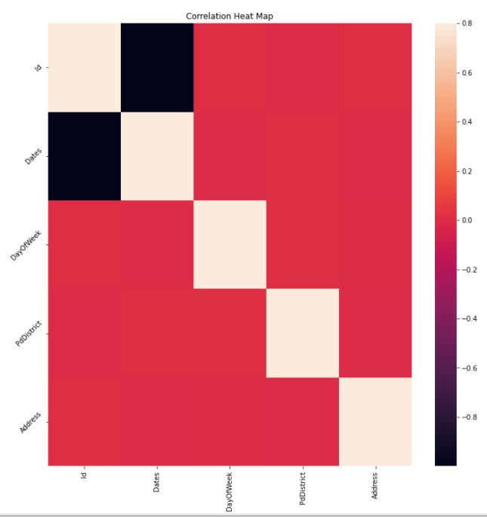
Test Dataset:
Between all features to show which columns depend on which, and to what extent, for training data
: 100% correlated
: 0% correlated

Slide 9
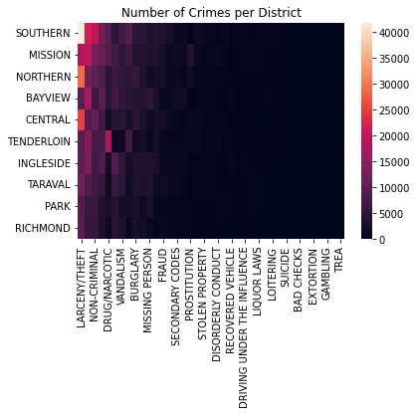
Number Of Crimes per District

Slide 10
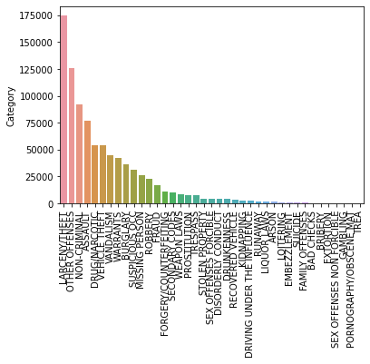
Bar-Plot: is a chart or graph that presents categorical data with rectangular bars with heights or lengths proportional to the values that they represent. The bars can be plotted vertically
1) To see the frequency of each crime
Conclusion
We deduce that ‘LARCENY/THEFT’ is the most frequent

Slide 11
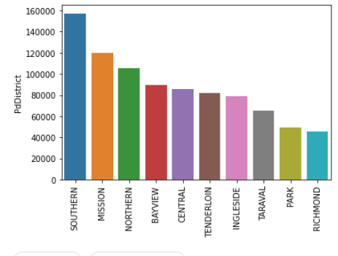
2) To see which PdDiscrit (Training-Data)has the most crimes
3) To see which PdDiscrit
(Test-Data)has the most crimes
Conclusion
Southern has the most crimes

Slide 12
Data cleansing and features engineering steps:
-Checked for null values
-Looked for unique values in each column
-Box-plots for numerical-value columns to check for outliers ,found some in the X,Y columns and fixed them

Slide 13
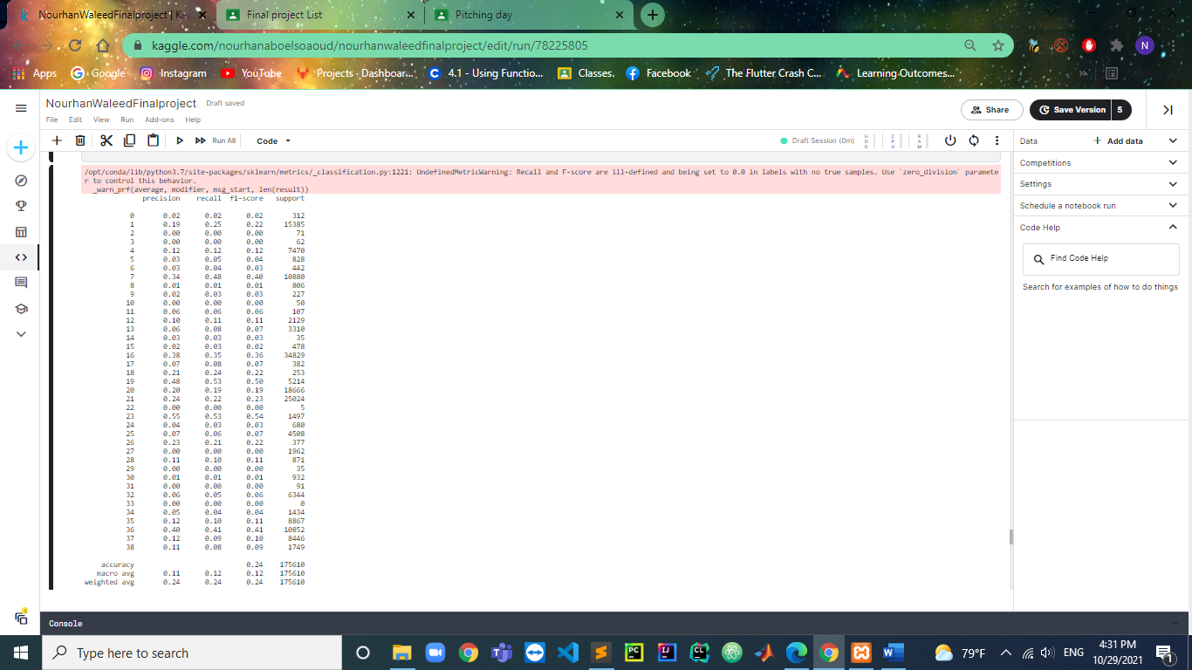
Models, Evaluation and Tuning:
Classification Report for Model 1 (Decision Tree)
Model Accuracy: 0.24

Slide 14
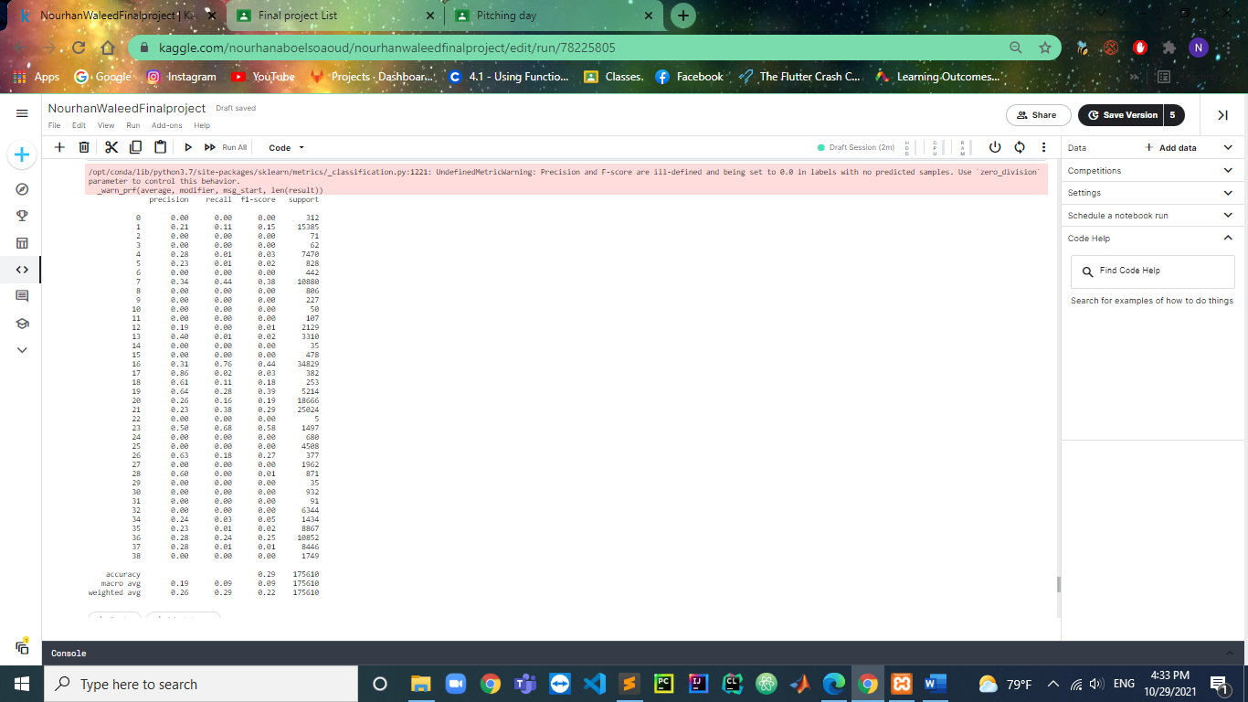
Classification Report for Model 2 (Random Forest Classifier):
Average Model Accuracy: 0.29
Train Accuracy: 0.3329741087838232
Test Accuracy: 0.28891862650190764
After Tuning:
Train Accuracy: 0.34567983839166105
Test Accuracy: 0.29070098513752063

Slide 15
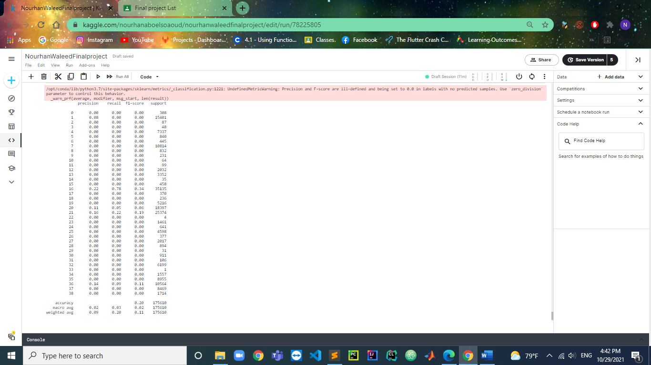
Classification Report for Model 3(SVM):
Model 3 Accuracy(SVM): 0.19924263994077787
After Tuning: 0.20007402767496157

Slide 16
Best Model Out of the 3:
Random Forest Classifier as it produces the highest accuracy in a short time

Slide 17
Thank you

